Slide 1

Preliminary Insights & Selected Best Practices
Photo by Online Marketing on Unsplash

Slide 2
Executive summary
Preliminary analysis of 5K Healthy Co records show time of arrival and healthcare professional
have an impact on total time spent at the facility
Average total wait time for all visits is approx. 40 minutes; longer average waiting times observed around peak hours (47.6, 48.3, and 46.4 minutes at 9, 12, 19 GMT respectively)
Wait and visit times vary by Doctor; patients waiting significantly longer to be seen by one specific Doctor vs. the rest (29.6 minutes vs. 21.7 minutes avg. of others)
Best practices to improve the overall patient experience include improving the condition of the waiting area and implementing queueing software
The condition of the wait area is the most important factor in determining whether patients want to return, and likely one of the easiest to improve
Scheduling software (e.g., QLess) allows patients to queue from anywhere, increasing patient satisfaction by 20% in recent case study
Planned next steps include a brainstorming session to develop long list of patient experience improvement initiatives

Slide 3
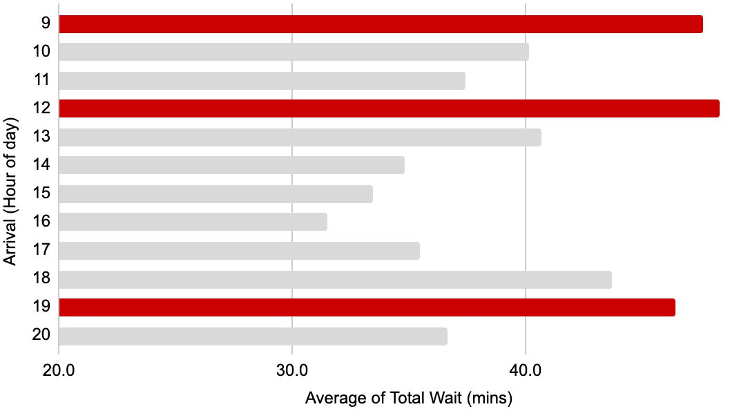
Visit durations are heavily influenced by arrival time and vary significantly across care professionals
Current
Check in
Avg: 2.8min
Vitals wait
Avg: 16.4min
Vitals
Avg: 5.1min
Doctor wait
Avg: 23.3min
Doctor
Avg: 6.4min
Payment
Avg: 3.6min
patient journey
Average wait time for all visits is approx. 40 minutes; longer average waiting times observed around peak hours
Wait and visit times vary by Doctor (also observed with vitals nurses, not shown)
Doctor | P-V Wait | Visit: Grp 1 | Visit: Grp 2 | Visit: Grp 3
Balla | 29.6 | 14.2 | 6.8 | 5.4
Campbell | 21.8 | 10.4 | 6.9 | 5.3
Campos | 21.4 | 10.0 | 6.9 | 5.3
Jankowski | 21.8 | 10.9 | 6.7 | 5.3
Yung | 21.6 | 10.5 | 6.7 | 5.4
Average | 23.3 | 11.2 | 6.8 | 5.3
9am, 12pm, and 7pm are the worst, with total wait of 47.6, 48.3, and
46.4 minutes respectively (well above 40 min avg.). Opportunity to optimize staff scheduling and/or consider capacity needs relative to demand.
Patients that see Dr. Balla have a significantly higher post-vital wait than patients seen by others. Dr. Balla also spends significantly longer with Group 1 patients. Opportunity to scale best practices and incentivize improved behaviors.
Source: Healthy Co provided patient data, 2019 (5K records)

Slide 4
Best practices include improving wait area condition and implementing software to uplevel experience
The condition of the wait area is the most important factor in determining whether patients want to return
% of patients who say X would cause them not to return to a specific provider:
Unpleasant waiting area
Long wait time
11%
Patients who found the waiting room unpleasant were also 4X more likely to be dissatisfied with their overall experience (Qualtrics Healthcare Pain Index)
Scheduling software (e.g., QLess) allows patients to queue from anywhere, increasing patient satisfaction
Software such as QLess allows patients to check in via text, apps, website, in-person kiosks, etc.
Sophisticated algorithms deliver accurate wait estimates; patients receive notifications to smoothen wait experience
Leads to lower perception of wait times and increases overall patient experience
29%
“With QLess we had a 20% increase in patient satisfaction attributed to shorter wait times. We have fundamentally changed how we deliver care.”
CEO, Healthcare Organization
We expect that improving the wait area condition to be quick and relatively inexpensive to accomplish (to be further explored).
Source: https://qless.com/queue-management-for-hospitals-healthcare/
Early signals are promising, but we will validate whether similar solutions can have improve the patient experience at Healthy Co.

Slide 5
Next steps
Planned:
Brainstorm session to develop a long list of patient experience improvement initiatives
Recommended:
Prepare & conduct patient experience survey with Healthy Co patients
Understand current initiatives to improve provider performance
E.g., what is currently being done with the data?
Hold early conversations with software vendors to better understand offering

